Slide 1
UNIT-II
KCS- 01
SOFTWARE ENGINEERING
PART-I
Software Engineering

Slide 2
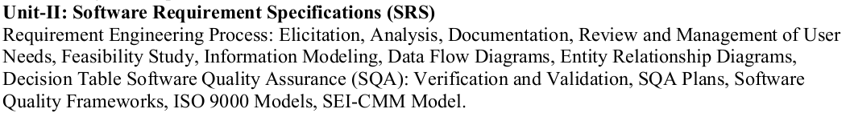
Syllabus

Slide 3
REQUIREMENT ENGINEERING
The key component of the software development is the requirement specification document (RSD) or software requirement specification (SRS) and the process of developing this document is called requirement engineering.
A missed or bad requirement can result into a software error which requires lots of rework and also lead to financial and legal implications.
Requirement: feature of the system or a description of something that the system is capable of doing in order to fulfill the system’s purpose.
Requirements describe the “what” of a system, not the “how”.
Requirements engineering produces one large document, written in a natural language, and contains a description of what the system will do without describing how it will do it.

Slide 4
REQUIREMENT ENGINEERING
IEEE defines a requirement as:
A Condition or capability
needed by a user to solve a problem or achieve an objective.
that must be met by a system to satisfy a correct, standard, specification document.
A Document representation of a condition or capability as in definition (a),(b).

Slide 5
REQUIREMENT ENGINEERING
The Input to Requirements Engineering is the Problem Statement prepared by the Customer.
The Output of the Requirements Engineering (RE) process is a system Requirements Specification called the Requirement Definition and Description (RDD).
The System Requirements Specification forms the basis for designing software solutions.

Slide 6
Types of Requirements
There are various categories of the requirements.
On the basis of their priority, the requirements are classified into the following three types-
Known requirements: Those that should be absolutely met.
Unknown requirements: Those that are highly desirable but not necessary.
Undreamt requirements: Those that are possible but could be eliminated.
On the basis of their functionality the requirements are classified into the following two types:-
Functional and Non functional
User and system requirement

Slide 7
Types of Requirements
Functional requirements:-
They define factors on what the software has to do and also called as product features
such as I/O formats, storage structure, computational capabilities, timing, and synchronization.
Non-functional requirements:-
They define the properties or qualities of a product including usability, efficiency, performance, space, reliability, portability, etc.
Constraints on the services or functions offered by the system
Examples: constraints on timing, development process and standards

Slide 8
User requirements:
written for the users
Include functional and non functional requirements
Specify the external behavior of the system with some constraints and quality parameters.
System requirements:
Derived from user requirements
Expanded form of the user requirements

Slide 9
REQUIREMENTS ENGINEERING PROCESS
Requirements engineering consists of the following
processes-
Feasibility study
Requirements Elicitation.
Requirements Analysis and Modeling.
Requirements Documentation.
Requirements Review(Validation).
Requirements Management.

Slide 10
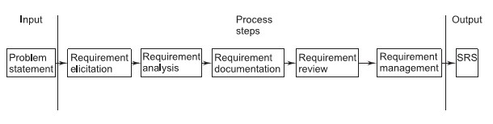
REQUIREMENTS ENGINEERING PROCESS
Fig: Process Steps of Requirements Engineering

Slide 11
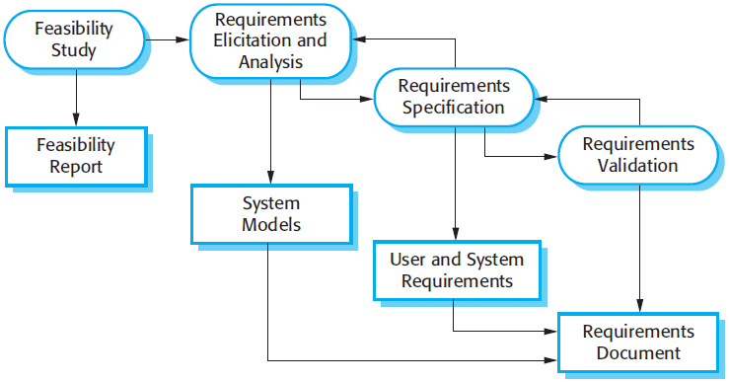
REQUIREMENTS ENGINEERING PROCESS
(Review)

Slide 12
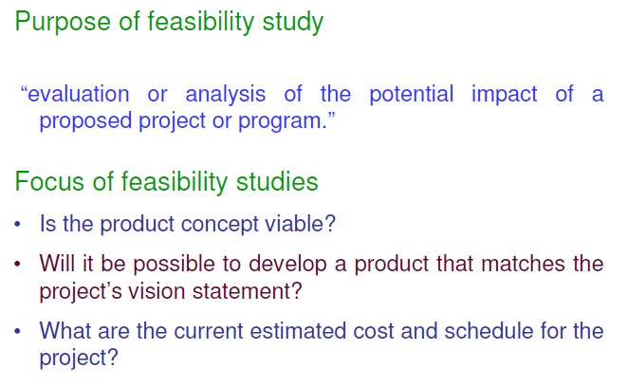
A. Feasibility Study

Slide 13
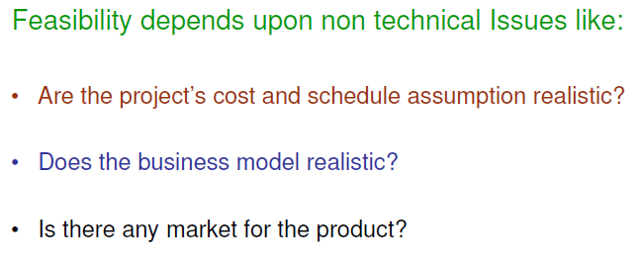

Slide 14
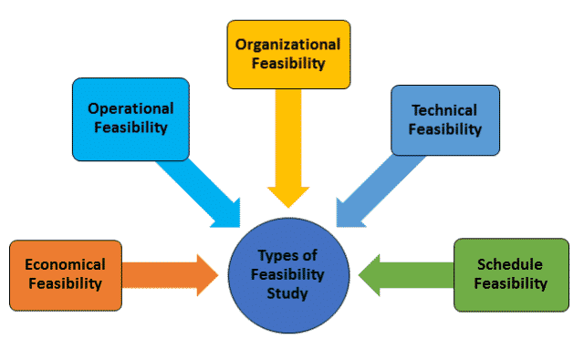
Feasibility study can be divided into following:
Economic feasibility
Legal feasibility/operational
Organizational feasibility (man power resources and work culture of organization)
Technical feasibility
Schedule feasibility

